Slide 1
ScreenerPlus APP
Team IntelliTech
Leveraging AI for Malaria Diagnosis into a mobile application.
Habeeblah Aberejo (Team Lead)
Taofeek Akintunde
Jafar Li-hammed
25th June, 2024

Slide 2
Introduction
ScreenerPlus is an app that scans blood smears if positive with malaria or not.
It also has the option to upload blood smear taken from third party microscopes.
It has option to capture blood smears using lenses or 100x zoom camera

Slide 3
Solution Overview
AI model trained to detect malaria parasites in blood samples.
Utilizes deep learning algorithms for a good accuracy.
Integrated into a flutter mobile application.
User-friendly interface for healthcare professionals and lay-man users.

Slide 4
Problem Statement
Most countries in west africa are known for high level of malaria cases,
About 97% of Nigerians are open to risk of malaria (WHO, 2023)
In 2022, Nigeria has highest percentage of global malaria cases
27% in the world and 55% in West Africa (World Malaria Report, 2022)
Manual diagnosis is time-consuming and prone to errors.
Give way for non-technical individual to test for malaria

Slide 5
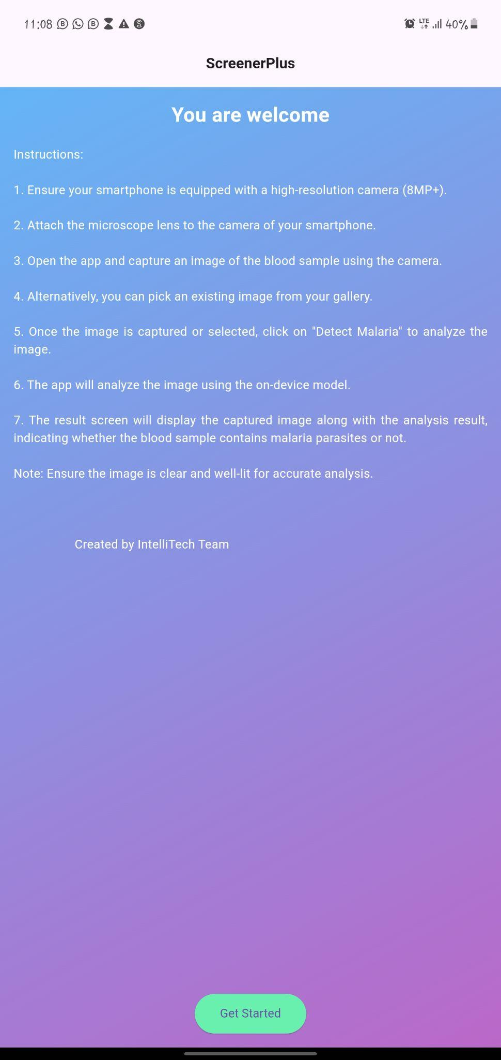
Key Features
User Interface:
Easy-to-navigate dashboard.
Real-time detection and result display.
Accuracy and Speed:
High precision in parasite detection.
Fast processing time for large datasets.
Reporting:
Generates detailed diagnostic reports (In future)
Exportable data formats in PDF CSV (In future)

Slide 6
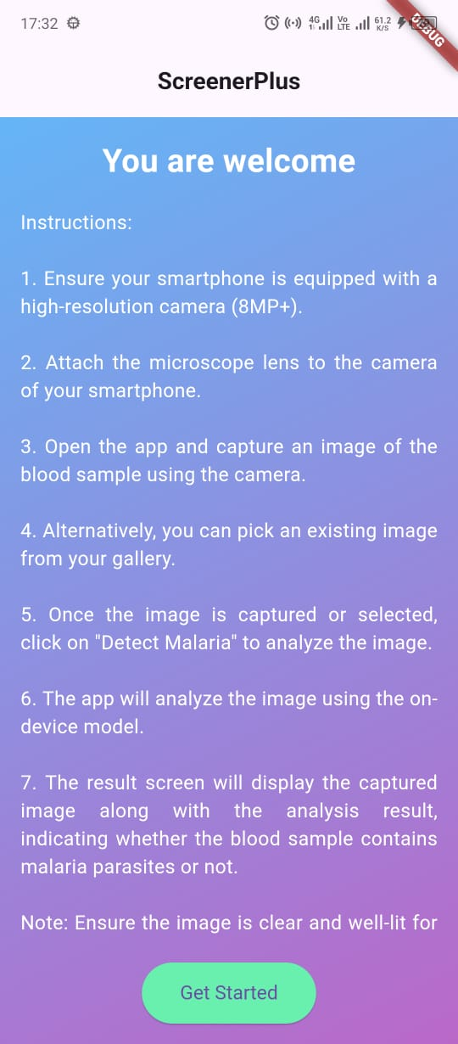
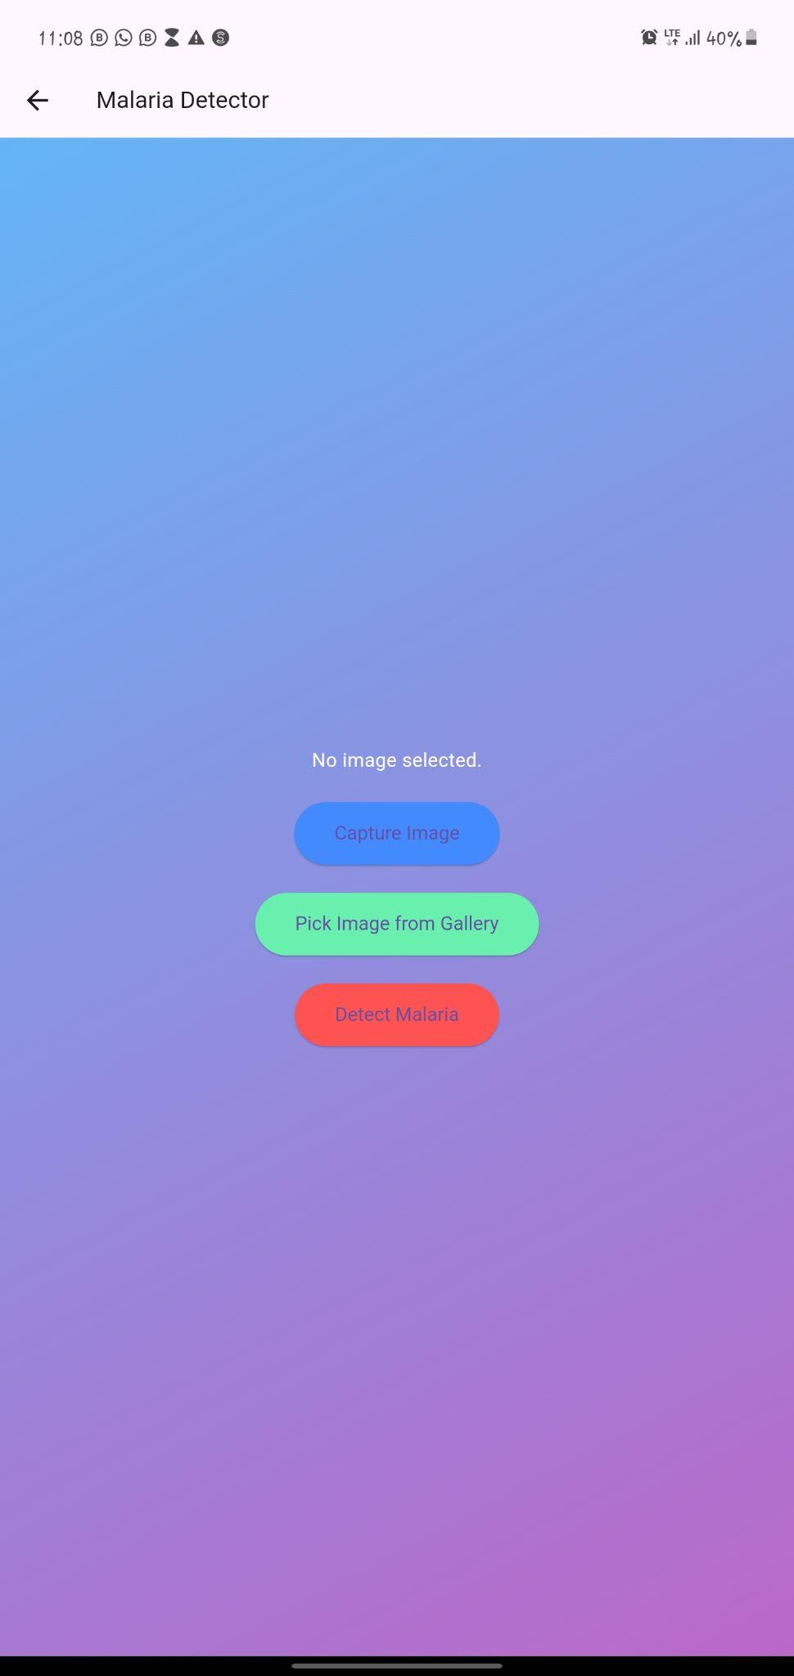
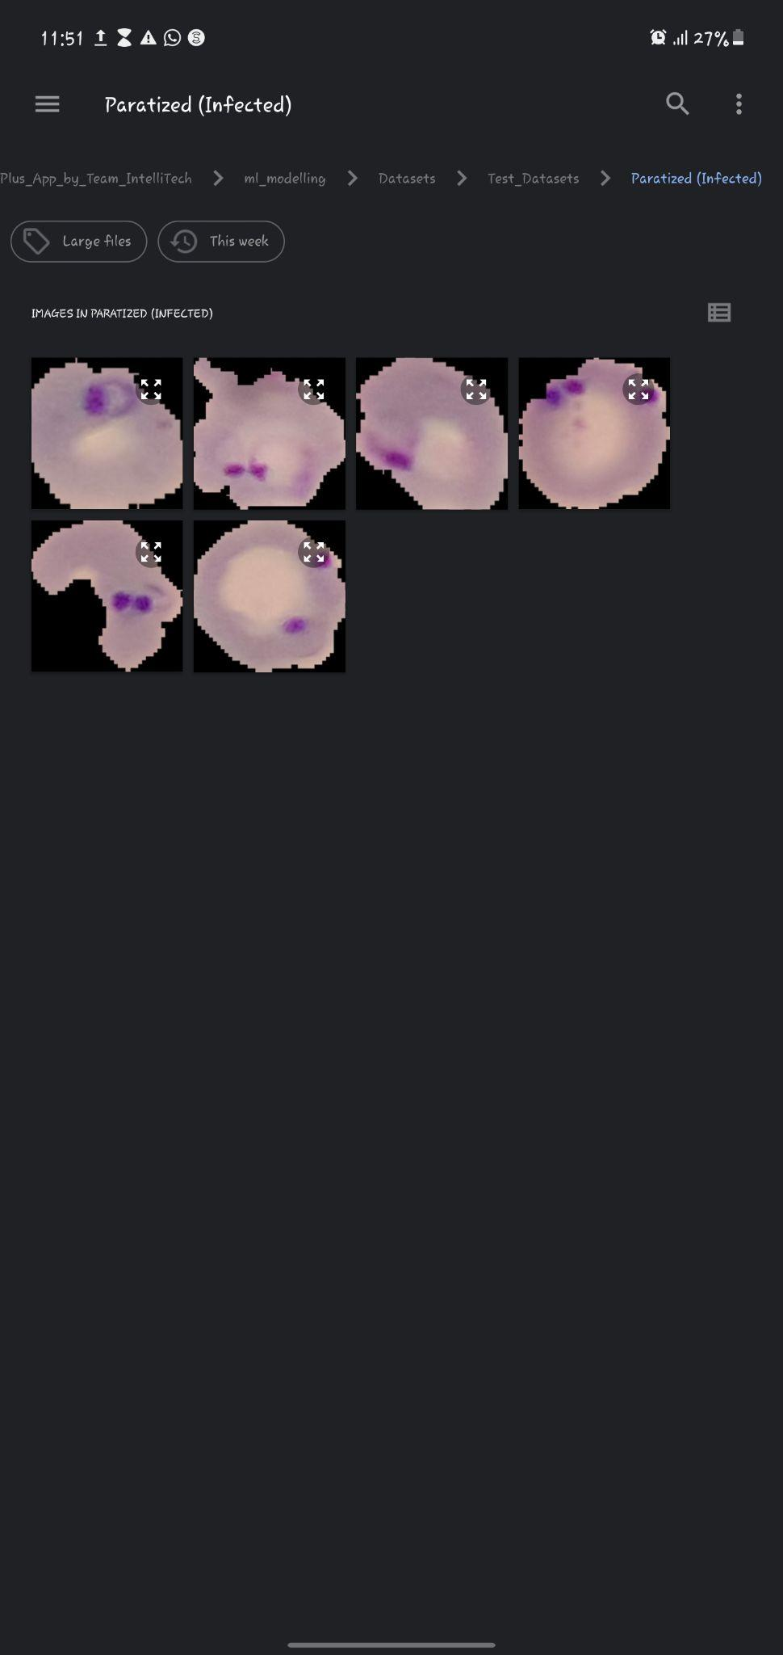
Positive Use-Case

Slide 7
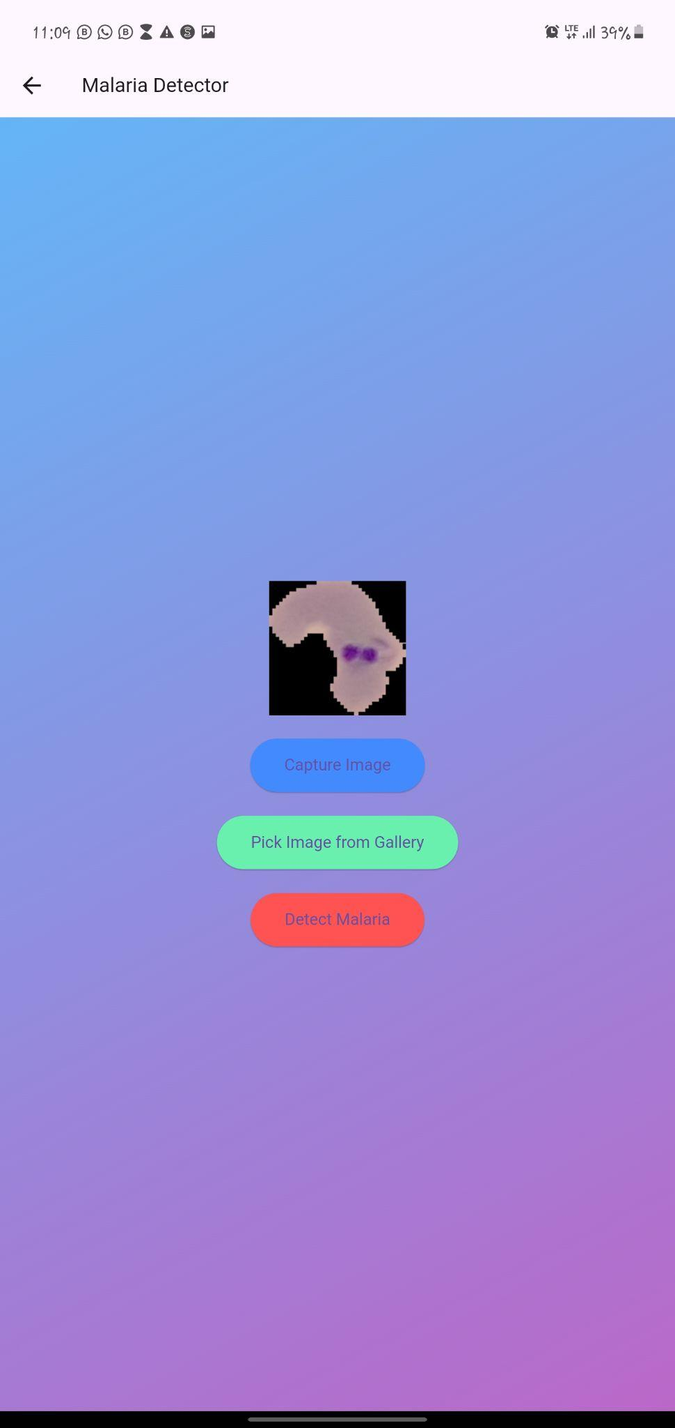
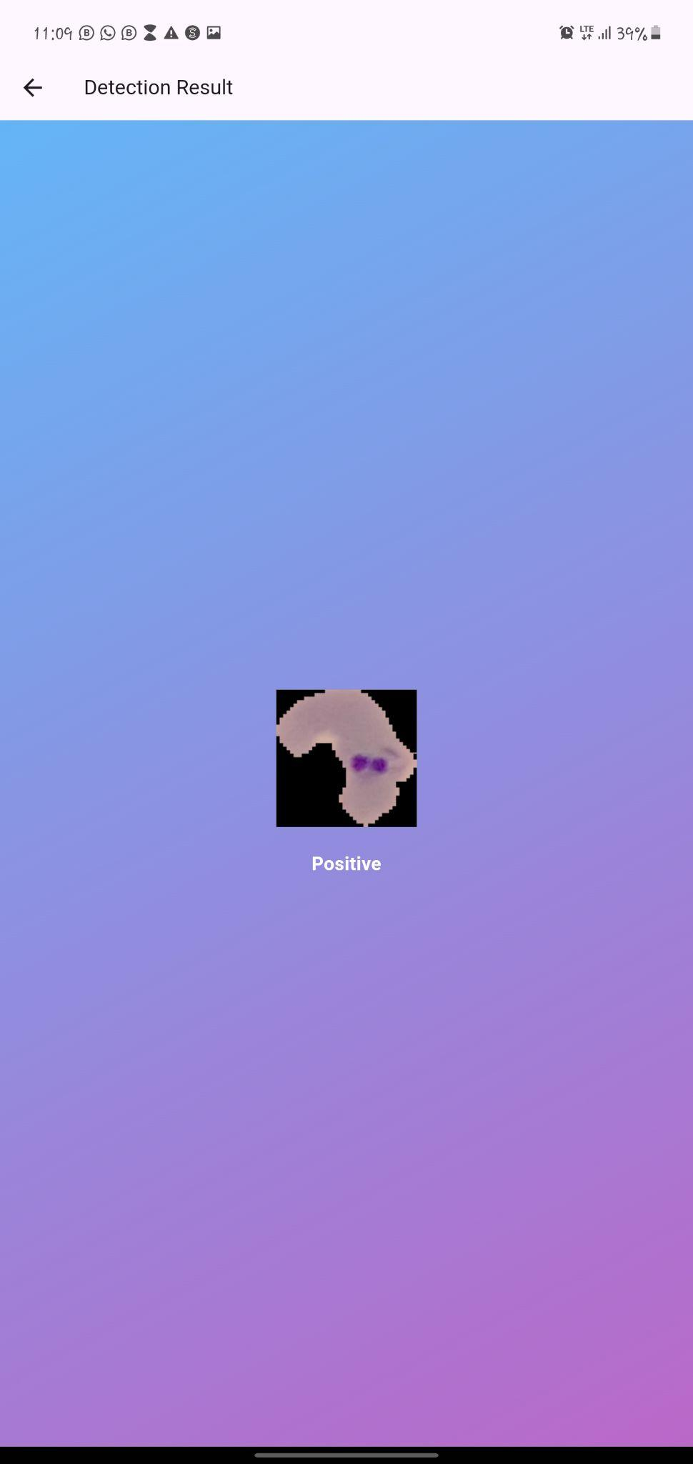
Positive Use-Case

Slide 8

Negative Use-Case

Slide 9
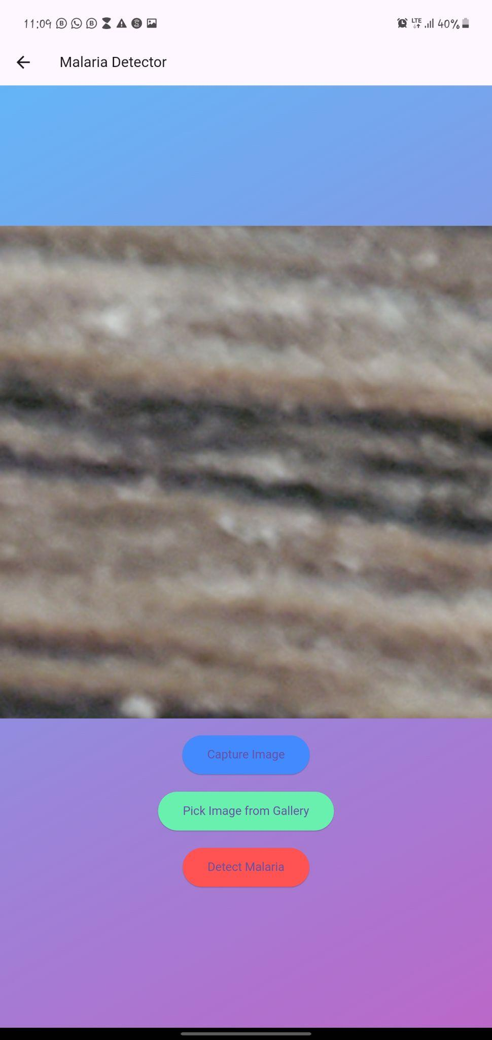
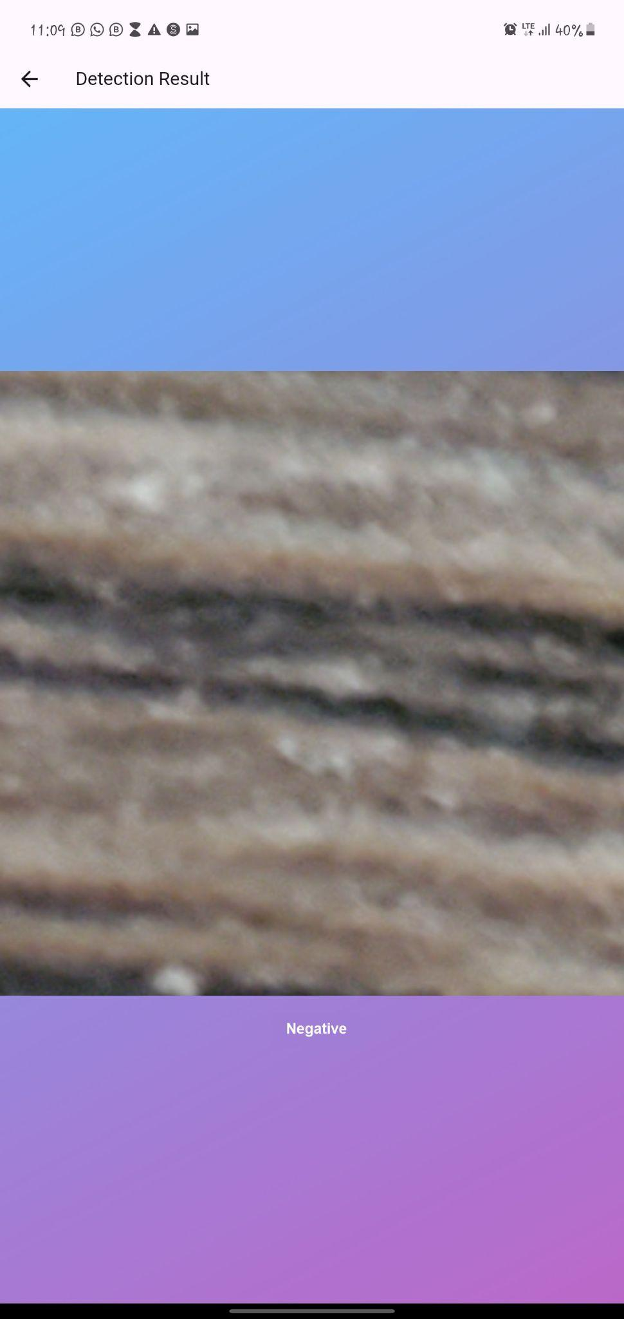
Negative Use-Case

Slide 10
Technical Details
Used available dataset after proper cleaning
Training process and validation.
Model: Tensorflow, Numpy, TFLite,
Backend: Python, TensorFlow/Keras.
Deployment: Cloud-based or on-premises options.

Slide 11
Case Study
Real-World Application:
Example of successful implementation in a clinic or hospital.
Feedback from healthcare professionals.
Impact on diagnosis speed and accuracy.

Slide 12
Benefits
For Healthcare Providers:
Reduces diagnostic workload.
Enhances diagnostic accuracy.
For Patient:
Faster diagnosis leads to quicker treatment.
Reduces the risk of complications from delayed treatment.

Slide 13
Thank You

